Slide 1


Career Development Competency Program for First Nation Practitioners
Dave Redekopp
President, Life-Role Development Group Ltd.

Slide 2
Career Development Competency Program
Designed originally for Alberta Human Services’ (HS) Career and Employment Consultants
Competency-based – attendance, participation & assignments are required
Recognized by and contributes toward:
  IAEVG’s “Educational and Vocational Guidance Practitioner” (EVGP) designation
  “Global Career Development Facilitator” (GCDF) designation

Slide 3
New Courses Added to Introduce the Program
Career Development in Community (2 days)
  How do career & employment services fit into broader community efforts regarding health, economic wellbeing, social wellbeing & community development?
Career Development and Employment Services Administration (2 days)
  How do career & employment services work operationally? How do we go from policy to practice to filling out forms (and why)?

Slide 4
Existing Courses
Foundations of Assessment (4 days)
  Basic counselling techniques
  Core career development ideas
Assessment: Investing in Strength (4 days)
  Variety of ways of finding client strengths and creating plans to enhance strengths and reach goals
Work Search Strategies (3 days)
  Helping clients find work

Slide 5
Existing Courses (cont’d)
Labour Market Information 101 (LMI 101) (2 days)
  Fundamentals of finding and using LMI
Using Tests and Tools (2 days)
  Finding, analyzing and using tests and career development resources
Facilitating Individual & Group Learning (3 days)
  Helping individuals acquire skills, knowledge & attitudes

Slide 6
New Courses to Supplement the Program
Work Maintenance: Providing Post-Employment Supports (2 days)
  How do we support people who gain employment so that they can stay employed? How do we help their families, employers & community?
Making it Work: Putting Skills into Practice (2 days)
  How can we make sure we know which skills to use and when?
  Actors are deployed here for practice sessions!

Slide 7
New Courses Currently Under Development
Advanced ESD Policy (2 days)
  What are the details of ESD policy? How do we interpret and apply policy? How do we keep up with changes?
Poverty, Self-Care & Crisis Management in Community (3 days)
  How do we provide effective service and look after ourselves in rural, isolated and poor communities where crisis is normal?

Slide 8
New Courses Currently Under Development (cont’d)
Integrating Programs and Services (2 days)
  How can we integrate programs and services inside and outside our community to make the best use of available resources and ensure clients don’t slip through the cracks?

Slide 9
By the Numbers…
10 courses now; 3 to be added
25 training days now; 32 in total
175 training hours now; 214 in total
15 facilitators
9 cohorts or groups of participants
6 training locations (Calgary, Edmonton, Lethbridge, Saint Paul, Slave Lake, Wetaskiwin)

Slide 10
By the Numbers (cont’d)
6 groups of about 22 each now have taken 10 courses (by end of 2014)
  130 in total, approximately
  1 “catch-up” group was woven into the above
  Graduates so far: 79!
    About half a dozen may complete in the next month
3 new groups of about 20 each started in September / October, 2014 – they will be done by July, 2015
Grand total who have been in or are in the program: 190!

Slide 11
By the Nations (so far)…
Alexander
Alexis
Beaver Lake
Bigstone
Blood Tribe
Cold Lake
Dene Tha’
Driftpile
Duncan’s
Ermineskin
Frog Lake
Heart Lake
Horse Lake
Kapewe’no
Kehewin
Loon River
Louis Bull
Lubicon Lake
Maskwicis Employment Centre
Montana
O’Chiese
Paul
Piikani
Saddle Lake
Sampson
Siksika
Stoney
Sturgeon Lake
Sucker Creek
Sunchild
Tribal Chief Ventures
Tsuu T’ina
Whitefish Lake (Goodfish)
Whitefish Lake (Atikameg)
Woodland

Slide 12
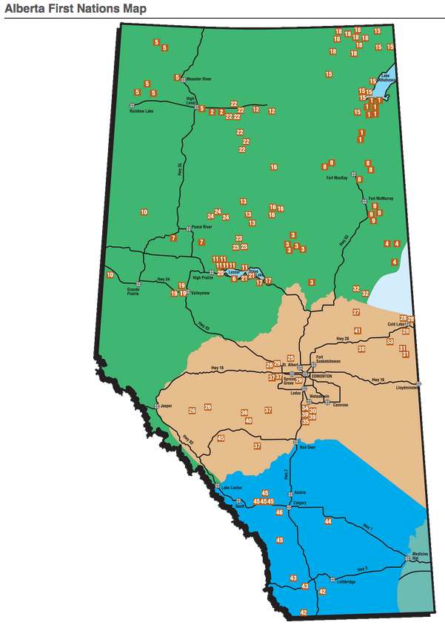

Slide 13
Challenges
The impediments to learning are significant; the impediments to applying the learning are more so
The logistics of hiring did not always match up with the schedule of the training
The career contexts of FN clients on reserve are very, very different than the vast majority of non-FN Canadian clients

Slide 14
Strengths & Successes
Managers and Directors attended the training
Strong government support & cooperation
  AANDC funded the program and the training adequately or better
  Alberta Human Services provided materials and allowed use of content, and will register graduates in its HRIS
  Nations accommodated a great deal of training time
Credentials are important – IAEVG & GCDF helps

Slide 15
Strengths & Successes (cont’d)
Getting the same training as provincial government staff is important
Nations adapted the content & provided the context
  They will take what they can and adapt to their needs
Graduation rate is high; overall program success for clients is dramatic

Slide 16
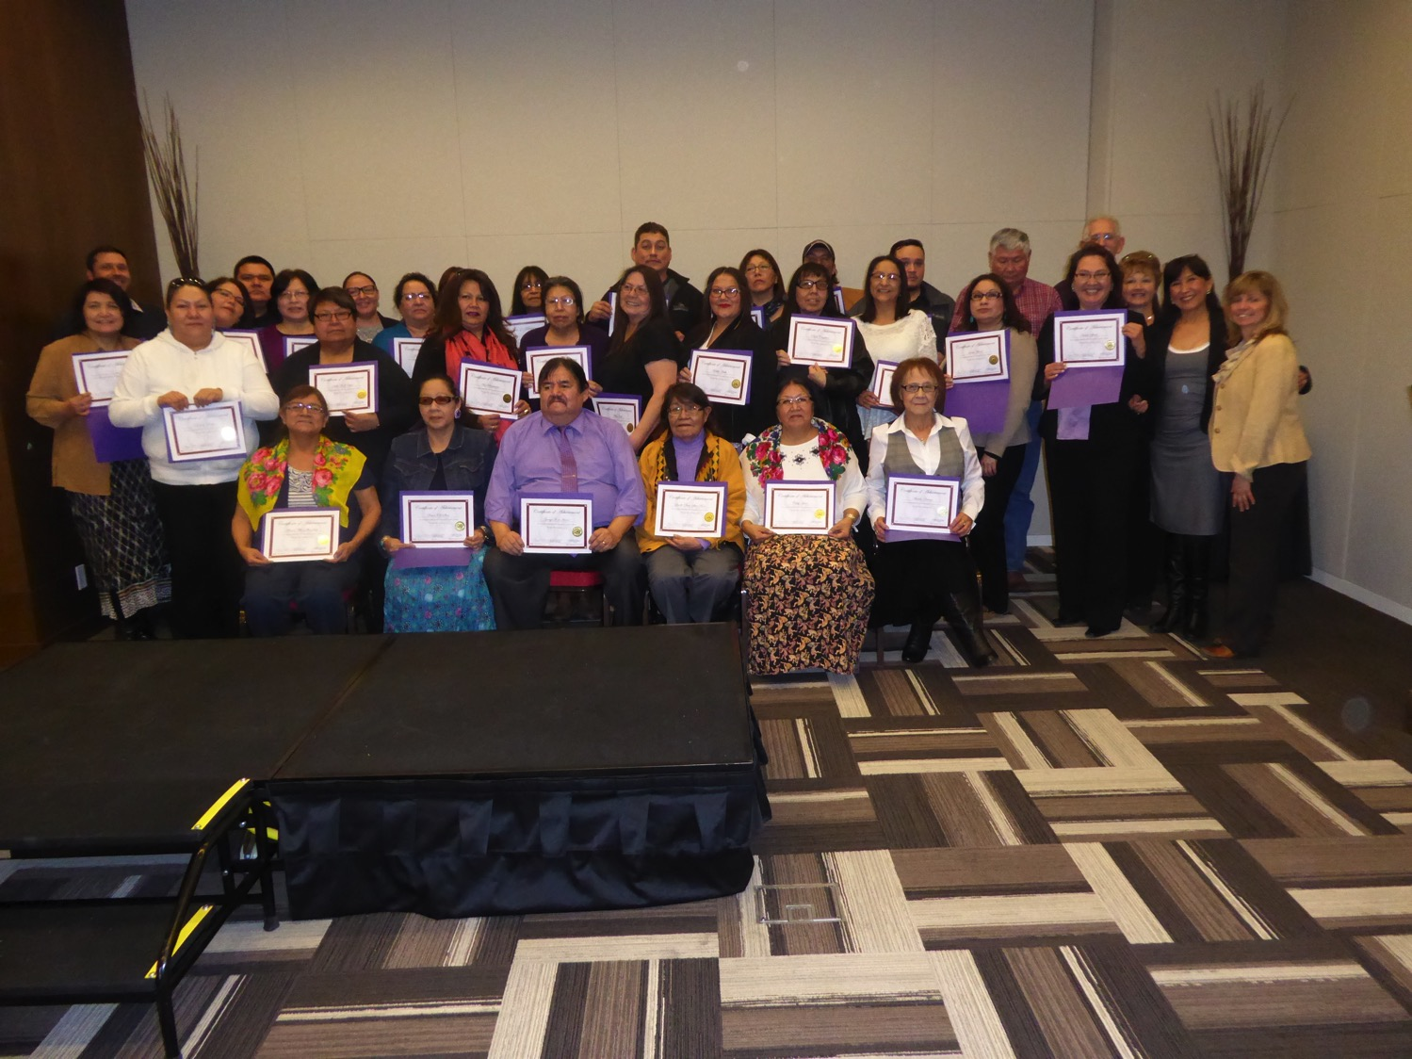

Slide 17
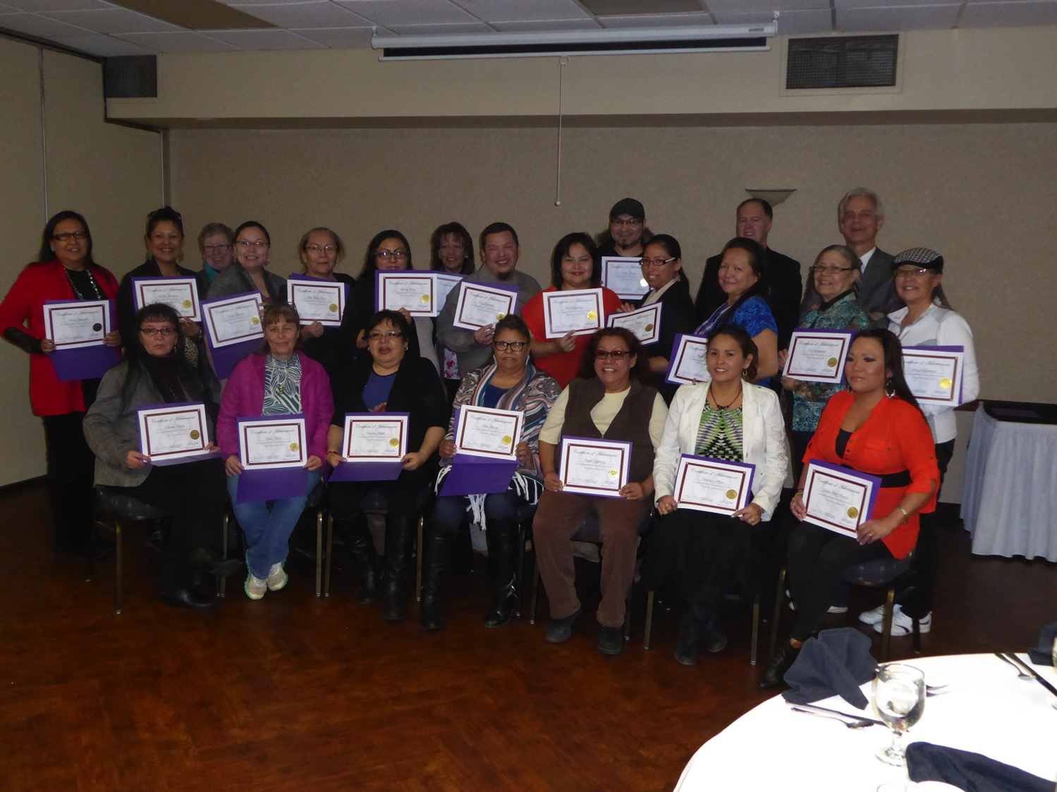

Slide 18
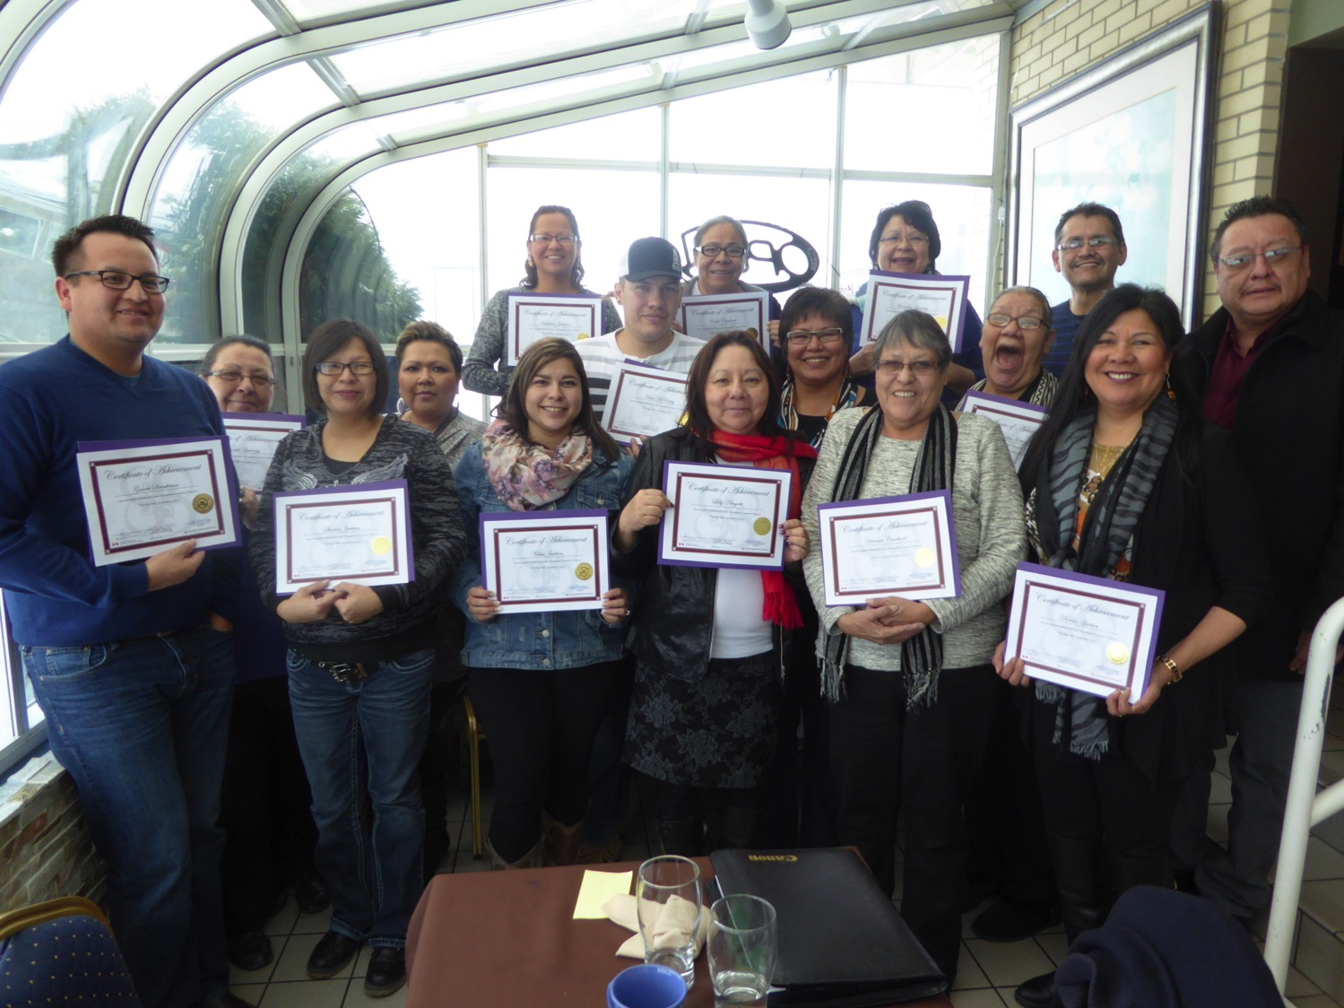

Slide 19
Wait – there’s more!
Currently working with AFOA – Alberta to develop a management training program for Social Development Directors
  6 courses ranging from “Leadership & Ethics” to “Financial Accounting & Reporting” plus a “capstone” course to put everything into practice

Slide 20
All Feedback is Welcome!
E-mail or phone Dave Redekopp:
780 451 1954
liferole@telusplanet.net

