Slide 1
Social Media & Work SearcH “The missing link”
ACDC 2016
Samantha Schellenberg, BA, RRP, CCDP – Owner, CHOICE WORKS Career Transitions
Facilitator, Designer, Trainer – Alberta Human Services

Slide 3
SESSION OBJECTIVES
Enhance knowledge on emerging work search and social media trends currently impacting job seekers.
Explore bridges and barriers that technology has created for career professionals and their clients.
Collaboratively develop Best Practices for coaching job seekers in the age of social media.
Notes:
SMALL GROUP – 20 MINS

Slide 4
POWER OF SOCIAL MEDIA & ONLINE NETWORKING
YOUR NETWORK & RELATIONSHIPS
YOU
Service Providers
Stakeholders
Your Boss
Future Prospects
Colleagues
Peers
Past Colleagues
Clients
Customers
Public
OPPORTUNITY:
INDUSTRIES
SECTORS
REGIONS
Gen X,
Gen Y
Boomers
Zoomers
YOUR NETWORK

Slide 5
ONLINE PRESENCE
ATS
ONLINE ED
SPORTS & ACTIVITIES
BANKING
INSTAGRAM
SNAPCHAT
YOUTUBE
GOOGLE PLUS
YELP
FACEBOOK
LINKEDIN
TWITTER
PINTEREST
MEETUP
FOURSQUARE
PROFILE Choose pic, info & settings.
YOUR DIGITIAL FOOTPRINT
“YOUR BRAND”
REGISTER
Account set up, choose email, password.
FEATURES Connect, Groups, Research
Notes:
ONLINE PRESENCE IS CREATED VIA ANY SOCIAL MEDIA TOOL – BOARD/COMMITTEE INVOLVEMENT, COMMUNITY SPORTS, TRAVEL PLANNING, DISNEYTRIPS, TRIATHLON….YOU NAME IT.
SOCIAL MEDIA & WORK SEARCH IS ABOUT CONTROLLING ONLINE PRESENCE & DIGITAL FOOTPRINT.

Slide 6
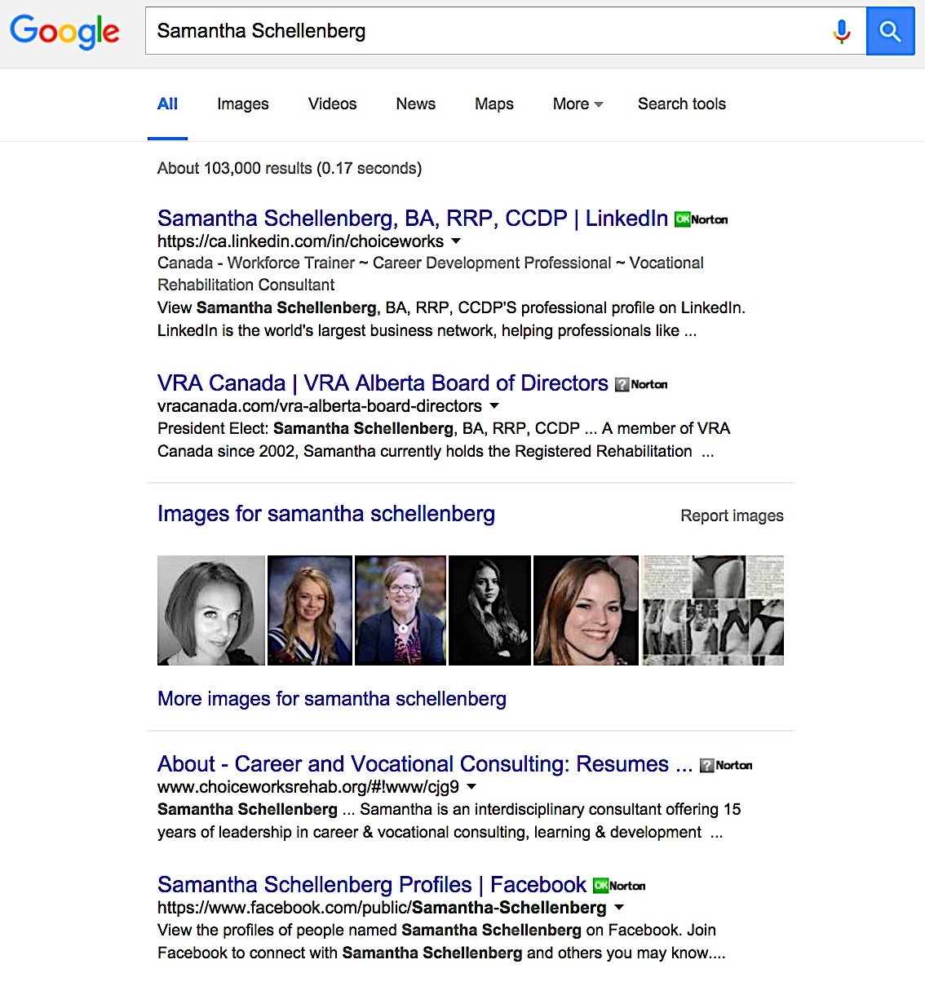
Why is Social Media used in Work Search?
Free Branding.
Push/Pull Trends.
Job Boards & Applicant Tracking Systems.
Frequency of Work Transitions/Alternatives.
Top Google Results.

Slide 7
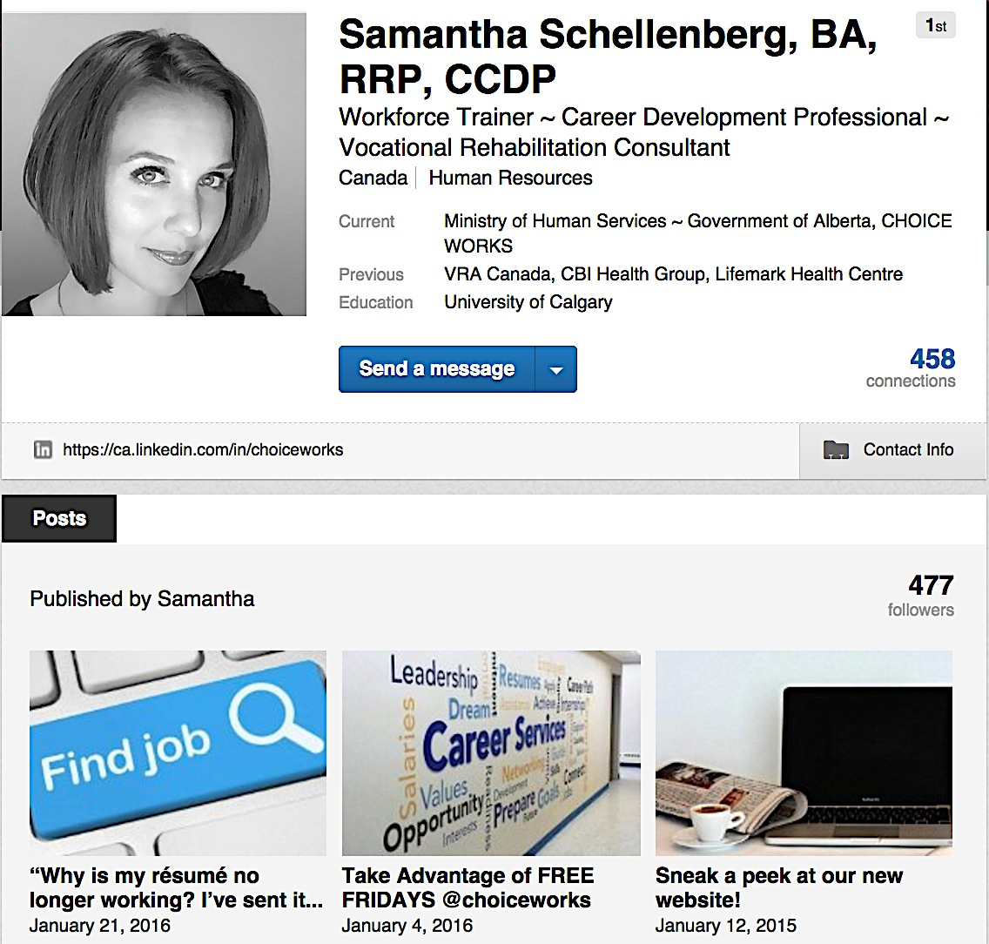
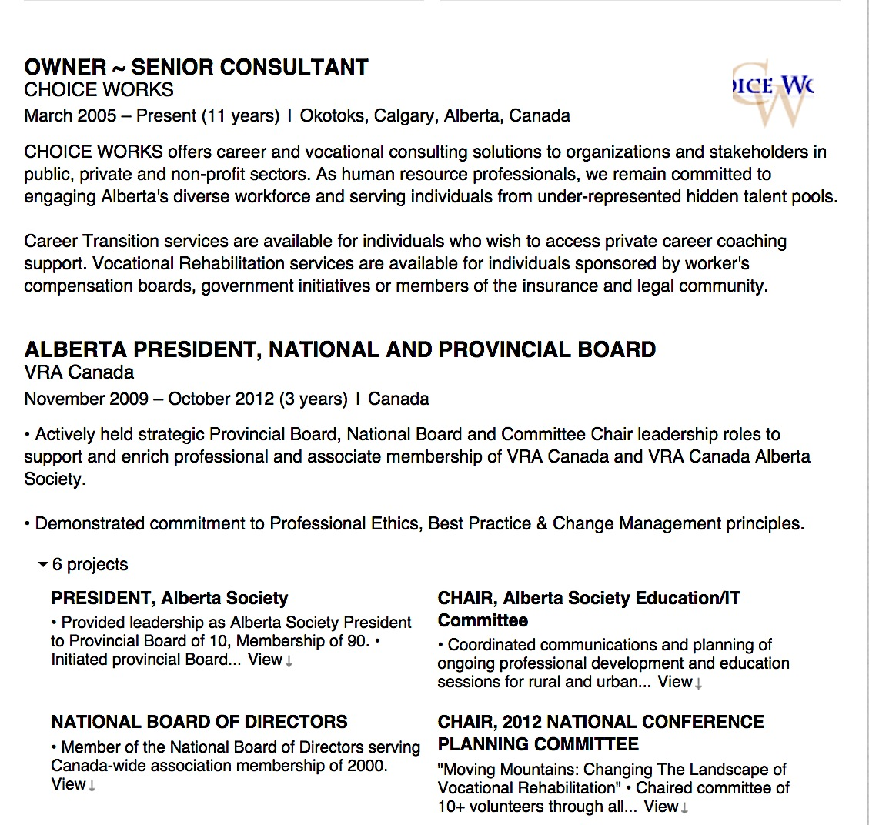
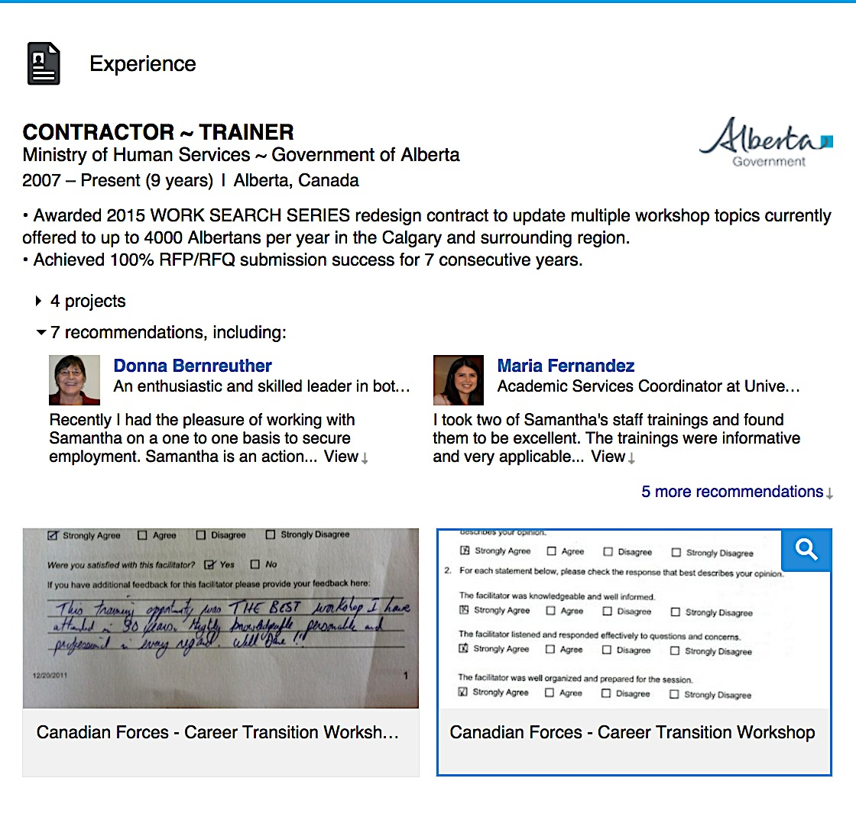
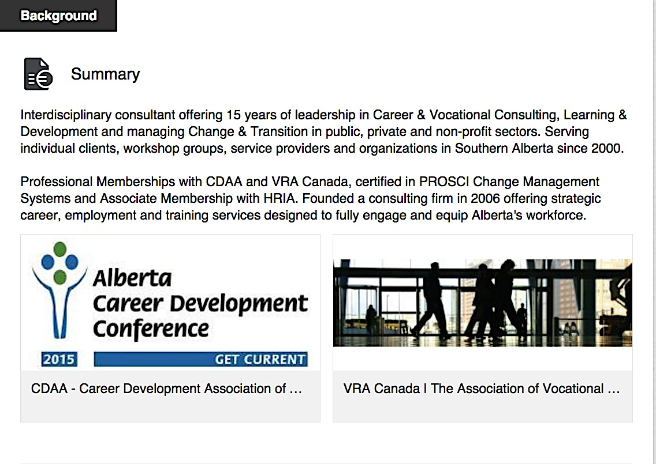
PROFILE FEATURES

Slide 8
PROFILE TIPS
Quality NOT Quantity. (Does your content justify your heading in 8 seconds?)
Does it get you noticed (personal branding) AND connected (networking, information gathering)?
Does it have accomplishments, instead of a list of duties?
Did you use Keywords (job ads), Qualifiers (descriptive words) and Quantifiers (how much, how many, how often)?
Did you spell check and edit?
Notes:
REFER CLIENTS TO 12 HOURS OF RESUME WRITING FOR:
TARGETING & BRAND
PROFILES/SUMMARIES
ACTION+RESULTS
KEYWORDS, QUALIFIERS, QUANTIFIERS

Slide 9
LINKEDIN FOR WORK SEARCH
NETWORK CONNECTIONS
COMPANY PAGES
GROUPS
EDUCATION
Notes:
LOG IN TRAINING GROUP – CONNECT WITH OTHERS IN THE GROUP

Slide 10
TWITTER SIGN UP

Slide 11
WHO SHOULD YOU FOLLOW?
@Raffi_RC
@JustinTrudeau
Notes:
SERVICE PROVIDERS AND RAFFI
NEWSBROADCASTERS OR STATIONS @petermansbridge or @cbcnews
ASSOCIATIONS (APEGA, CDAA, VRA CANADA)
EMPLOYERS, COMPANIES – PRIVATE SECTOR
UNIVERSITIES
MUNICIPLE, PROVINCIAL, FEDERAL GOVERNMENT DEPARTMENTS
MP’s
FAVORITY CELEBRITY
INDUSTRY LEADERS, CEO’S
Individuals WITH LIKE INTERESTS @slshockeyfan
NON-PROFITS
HOBBIES
SHOWS
HREMPLOYMENT LAW @stuartrader
RECRUITERS @jobvite

Slide 12
QUALITY TWEETS?
Noteworthy.
On Brand.
Strategic.
Engaging.
Tweets are public, and will be found in search results of major search engines (Google, Yahoo!, Bing, etc.)

Slide 13
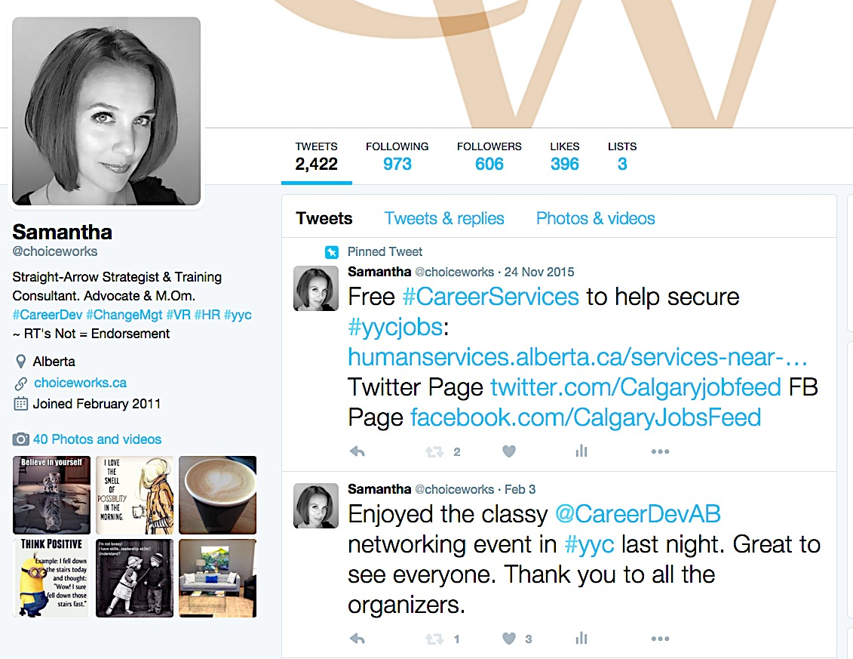
TWITTER FOR WORK SEARCH
Follow target Companies, Industry Leaders, Industry Associations, Peers and Hiring Managers directly.
TweetMyJobs – Sends personalized job listings via email, Twitter or your mobile. (similar to Job Alert)
Twellow – Yellow Pages for Twitter. Mashable - Job Search & Social Media Tips.
#yegjobs #yycjobs
Notes:
#yegjobs #yycjobs #APEGA #CityofEdmonton
TwitJobSearch - Job Search Engine for jobs posted on Twitter using keywords. Can follow Hiring Mgrs directly.
TweetMyJobs - Sends personalized job listings via email, Twitter or your mobile Device. (similar to GOA Job Alert) Used as a recruitment tool by various companies.
Twellow - Organizes users by category, making it easier to find the right recruiters to follow in your job search.

Slide 14
FACEBOOK FOR ORGANIZATIONS

Slide 15
FACEBOOK FOR WORK SEARCH
Clean up your profile. Delete questionable photos.
Use Privacy Locks. Avoid suspicious links.
Use long cryptic password (#, upper, lower case, !).
Log In/Log Out every time - disable “TAG” features.
Pay Attention! Watch for default settings.
Turn on Secure browsing settings (https://).

Slide 16
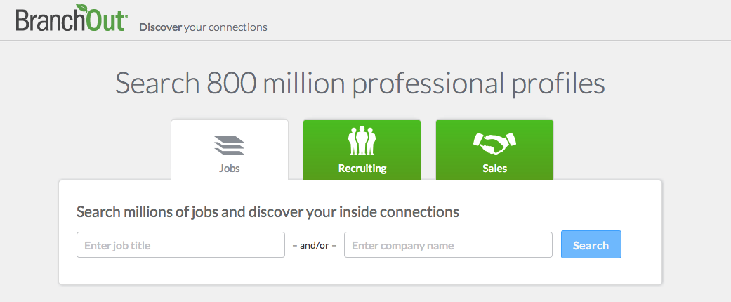
FACEBOOK JOB search APPS (3rd party)
BranchOut (Professional Network on Facebook)
**REQUIRES YOUR email, public profile info, gender, photo, education, location, work history and permission to access YOUR FRIENDS public posts, photos & information.

Slide 17
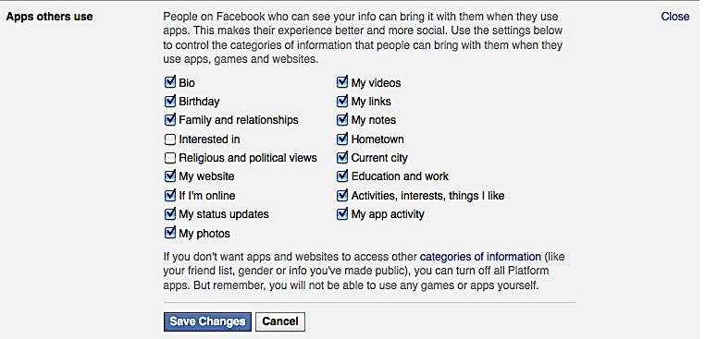
FACEBOOK LIABILITIES?
“400% higher level of consumer engagement with viral design”
Notes:
SOURCE: EDITIOR’s CHOICE SECTION (of the research literature) of week of Sept 23, 2011 SCIENCE MAGAZINE. Published ahead of print August 4, 2011.
Creating Social Contagion Through Viral Product Design: A Randomized Trial of Peer Influence in Networks. (Sinan Aral, Dylan Walker)
Information, Operations and Management Sciences, Stern School of Business. New York University, New York, New York. March 2011
Viral product design has econometrically identifiable impacts on peer influence and social contagion in new product diffusion.
Designing viral features into products can increase social contagion by up to 400%.
Existence of positive network externalities reinforce peer adoption, create a virtuous cycle of engagement and contagion.
IT enabled features “automated broadcast notifications” and “personalized invitations” used to spark product awareness, engagement.
Study seeking empirical evidence on the effectiveness in generating social contagion and product adoption. (9,687 facebook users, clicks)

Slide 18
BOT OR NOT?

Slide 19
TIPS: PRIVACY & CONFIDENTIALITY
GOOGLE Yourself.
READ Summaries of privacy policy, user agreement changes on Facebook, Twitter & LinkedIn.
LEARN how to adjust settings on EACH tool used. i.e.: ATS, company profiles, social media platforms.
CHANGE Passwords every 6 months. i.e.: Combination of #, Upper & Lower Case.
NEVER disclose IDENTIFYING information.
Notes:
6 PAIRS PILOT
3 GROUPS OF 4 PILOT

Slide 20
GOOGLE FREE RESOURCES
Job Seeker Checklist 2013
LinkedIn 101 by LinkedIn
Help Centers
Free Webinars
YouTube Channels
Blogs – Lists of job search tips on Facebook, Twitter, LinkedIn, Pinterest, Google

Slide 21
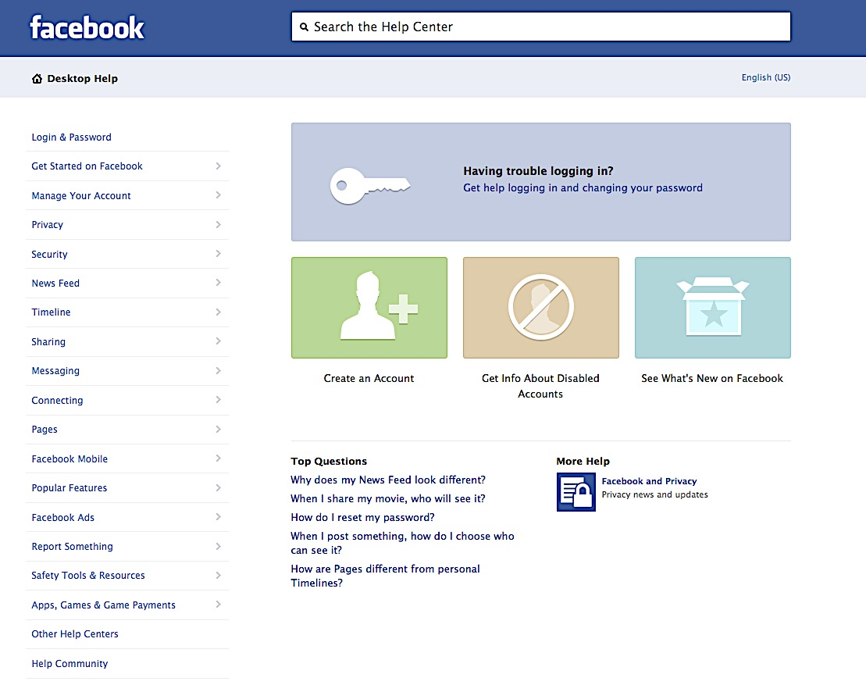
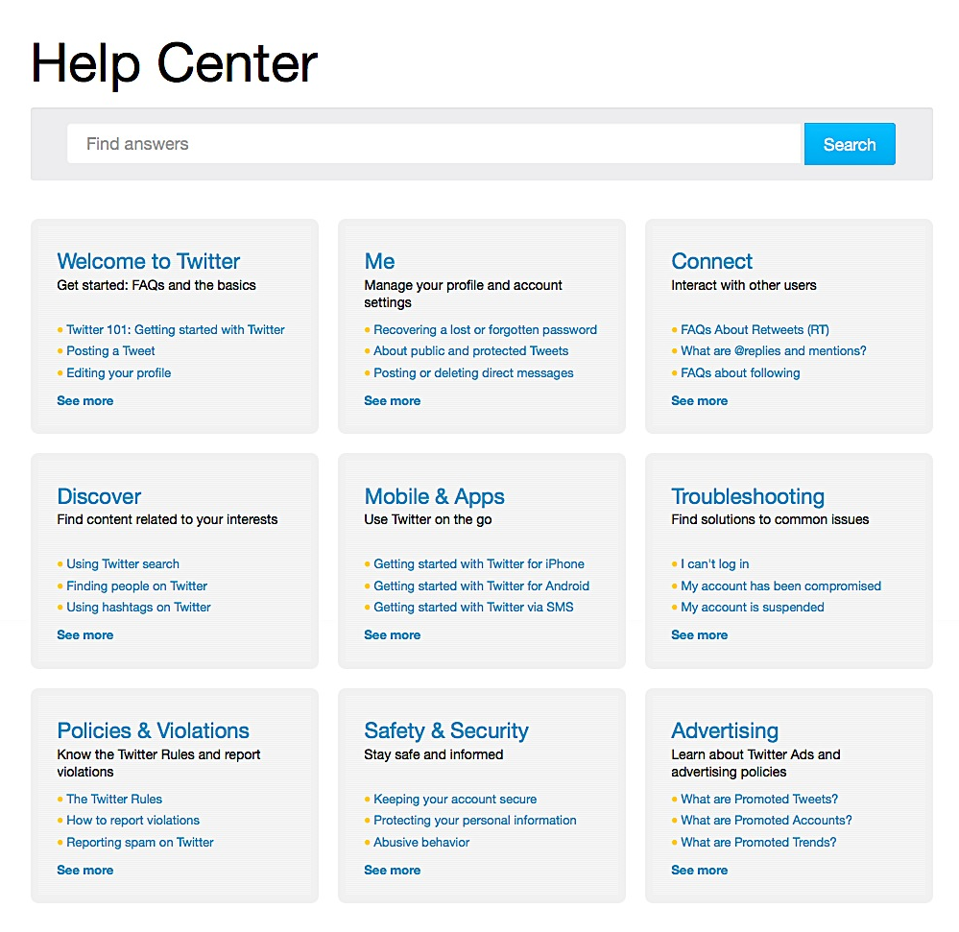
NEED HELP?

Slide 22
BRIDGES CREATED BY TECHNOLOGY
CAREER DEVELOPMENT - Ladder, Monkey-bars
NETWORKING AMPLIFICATION - Industry Transition, Promotion, Global Mobility
MENTORSHIP & SUCCESSION OPPORTUNITIES
LIVE CAPTURE LABOUR MARKET FLUCTUATIONS - used in conjunction with other research tools; similar to JOB BANK stats in Labour Market Quarterly reports, NOC funding limitations 2006, 2011, 2016.
SMALL BUSINESS GROWTH (low cost marketing, sales) ($15,000 package or free)
Notes:
SMALL GROUP – 10 MINS

Slide 23
Barriers CREATED BY TECHNOLOGY
FAVOURS Art of Applying NOT the Art of Working
CATEGORIZATION of trainable qualified candidates (as unqualified)
BURNOUT: 3-5 jobs/day? 3-5 profiles/day? 8 secs for 8 hrs?
COMPETITION OF ADVICE: HR vs. CAREER PROFESSIONALS
INSTA-CAREER EXPERTS, HYPER CERTIFICATIONS.
LACK OF ACCESS: NO computer access / skills to self train.
SELECTION: Screens for skills not required for role.
Notes:
SMALL GROUP – 10 MINS

Slide 24
BEST PRACTICE?
Enhanced knowledge on emerging work search and social media trends currently impacting job seekers.
Explored bridges and barriers that technology has created for career professionals and their clients.
Best Practices for coaching job seekers in age of social media?
Collaborative Small Groups: Choose group writer and speaker.
Develop “Top 10 List” of Best Practices for Coaching Job Seekers in the Age of Social Media
Notes:
SMALL GROUP – 20 MINS

Slide 25
CONTACT INFORMATION
SAMANTHA SCHELLENBERG, BA, RRP, CCDP
Choice Works Career Transitions
www.choiceworks.ca
ca.linkedin.com/in/choiceworks
@choiceworks

